Slide 1

Loan Approval Prediction
DATS 6101 PROJECT
Team Members:
Abhilasha Singh Aswin Balaji Thippa Ramesh Lixing Pan

Slide 2
Purpose
Summarize important background research and EDA
Answer the SMART questions by building models

Slide 3

Smart Questions
What are the financial and demographic profiles of high-risk versus low-risk applicants?
How does debt-to-income ratio impact loan approval, interest rates, and risk scores?
What is the relationship between loan purpose and repayment behavior, and how does it affect risk?
How does credit score impact interest rates, loan approval, and loan amount?
What are the strongest predictors of loan approval or rejection?

Slide 4

Dataset Details
Loan approval dataset sourced from Kaggle
Dataset contains,
20000 observations
36 variables
Applicant details: Credit score, annual income, employment status, debt-to-income ratio
Loan specifics: Interest rate, loan amount, risk score, loan purpose
Other financial metrics

Slide 5
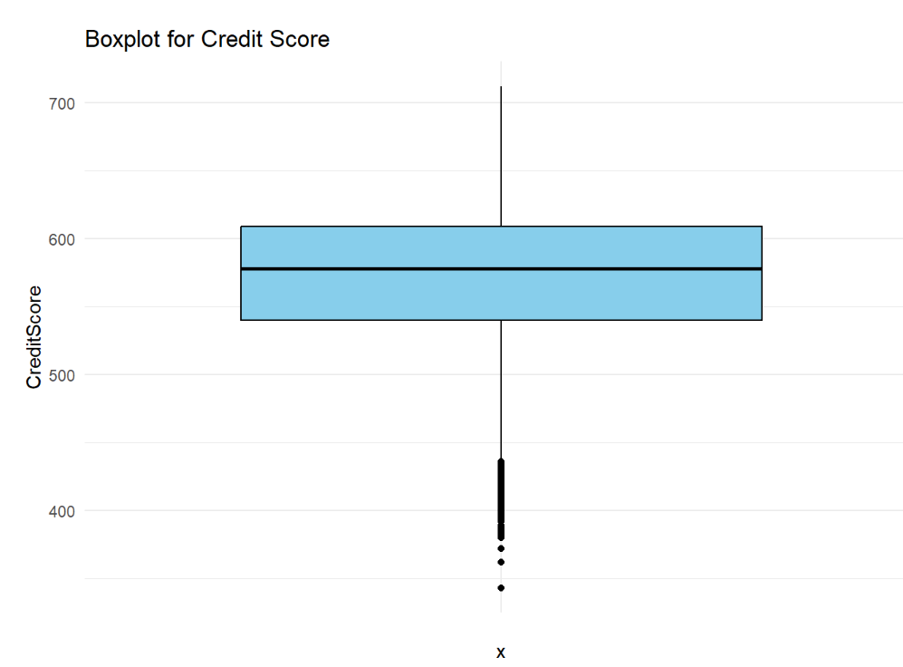
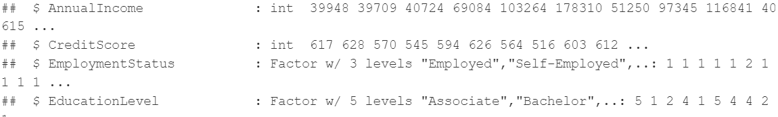
Exploratory Data Analysis (EDA)
Preprocessing Result
No missing values
No duplicate rows
Has outliers but useful
Data types allocation

Slide 6
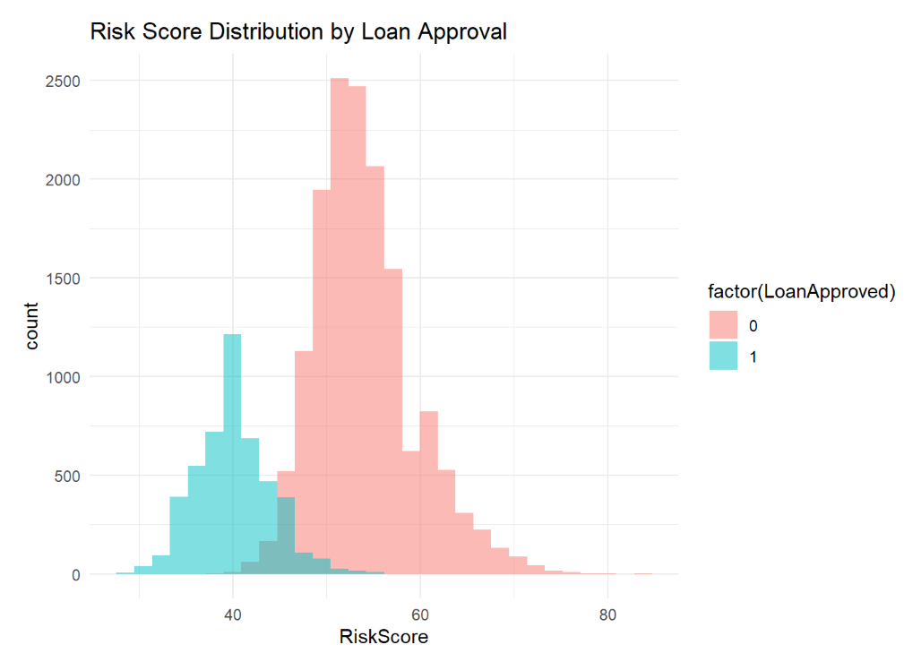
Exploratory Data Analysis (EDA)
Bivariate Analysis
Insight:
Loans are more likely to be approved for individuals with lower risk scores.

Slide 7
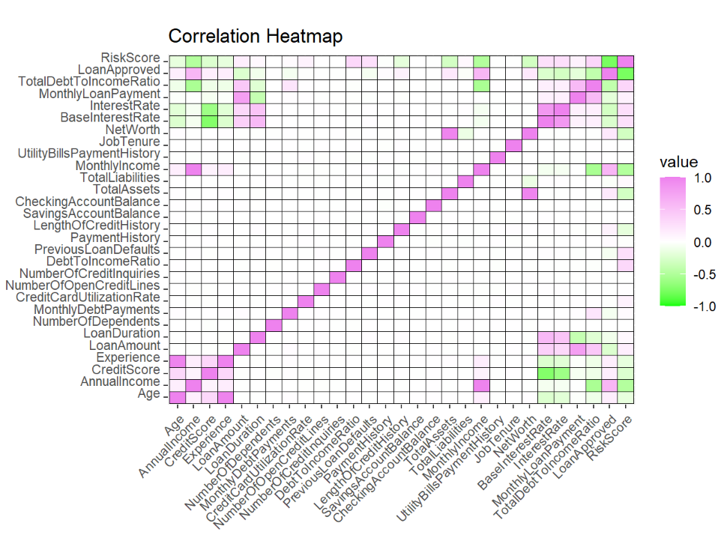
Exploratory Data Analysis (EDA)
Multicollinearity and correlation check
Dropped Columns: MonthlyIncome, Experience, NetWorth
Annual Income, Risk Score, DebtToIncomeRatio are some of the highly correlated columns with loan approval.

Slide 8
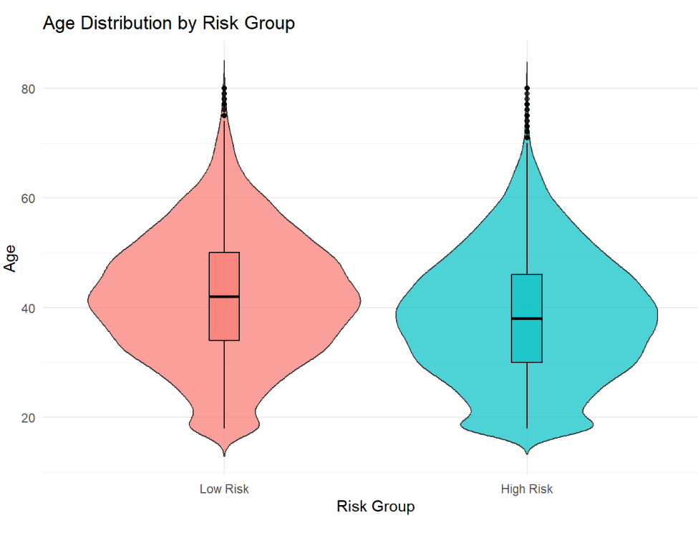
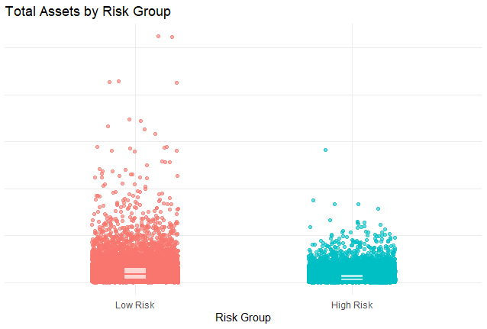
Exploratory Data Analysis (EDA)
1) What are the financial and demographic profiles of high-risk versus low-risk applicants for loan approval?
Insight:
Age is almost uniformly distributed among both risk groups.
Low Risk applicants have higher value of assets than that of high-risk applicants

Slide 9
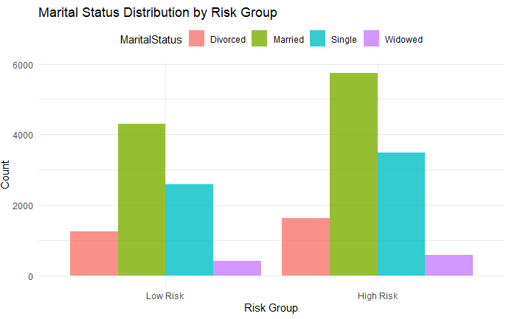
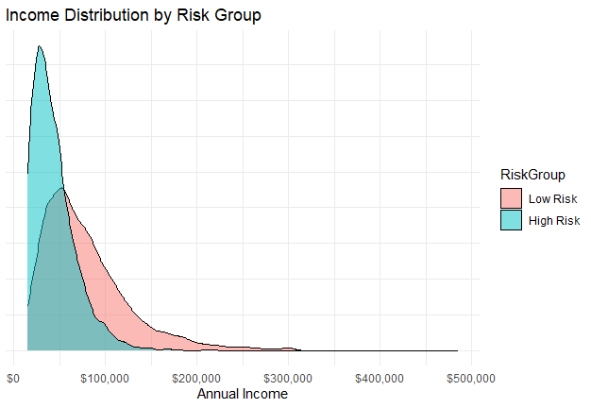
Exploratory Data Analysis (EDA)
1) What are the financial and demographic profiles of high-risk versus low-risk applicants for loan approval?
High-risk applicants have higher proportions of all the marital status. Suggesting no significance.
Low-risk applicants have higher & wider income. While high-risk applicants, have lower incomes.

Slide 10
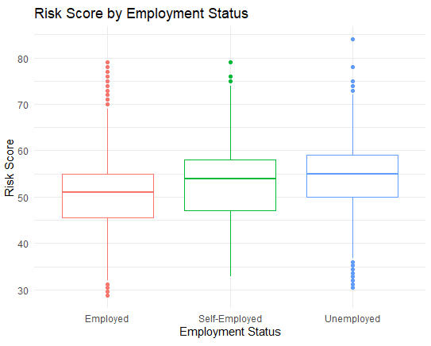
Exploratory Data Analysis (EDA)
1) What are the financial and demographic profiles of high-risk versus low-risk applicants for loa?
Insight:
Applicants who are employed have lower risk score.
While unemployed and self-employed applications have slightly higher risk score

Slide 11
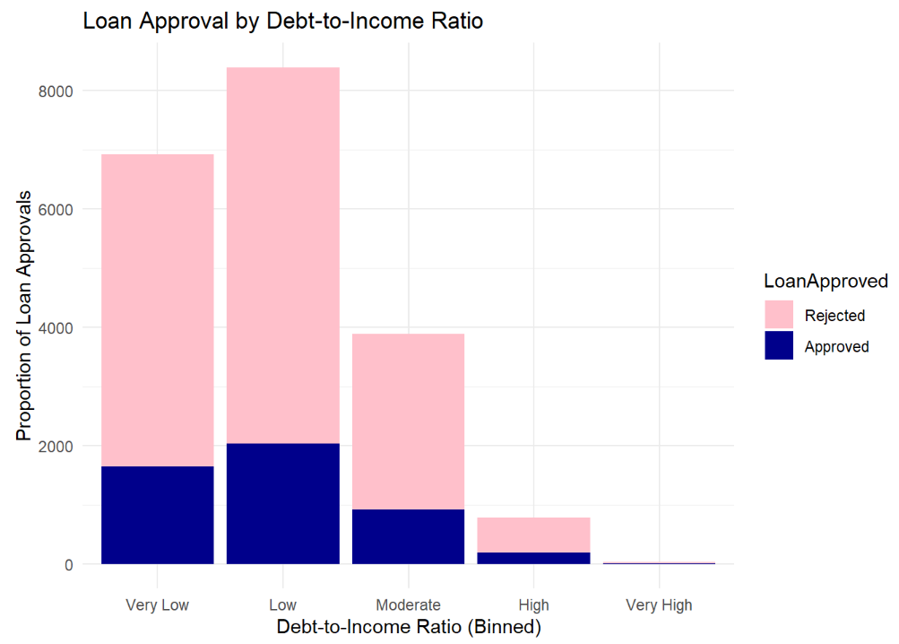
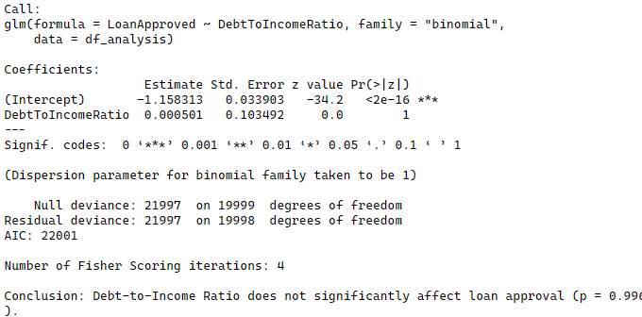
Exploratory Data Analysis (EDA)
2) How does the debt-to-income ratio impact loan approval, interest rates, and risk scores?
Insight:
Debt to income ratio is not related with loan approval.

Slide 12
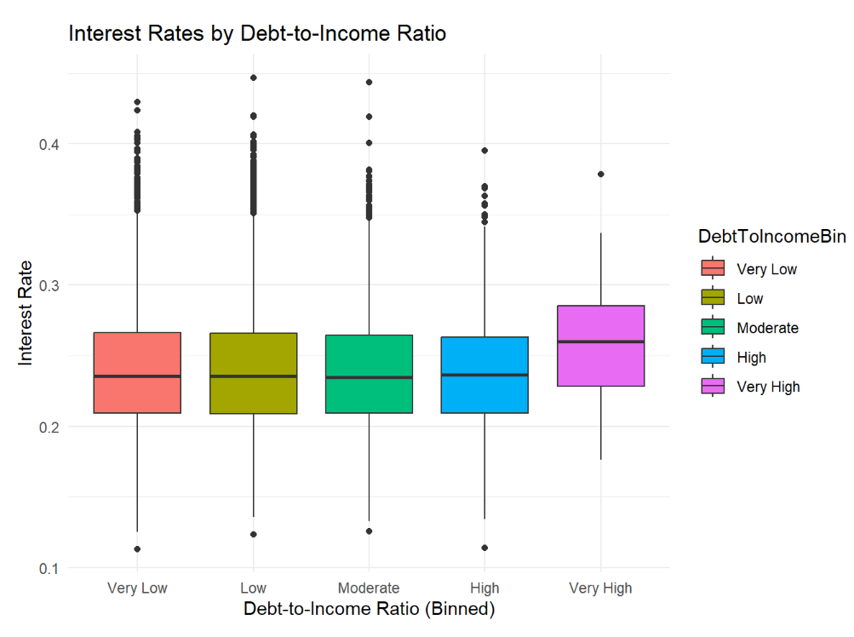
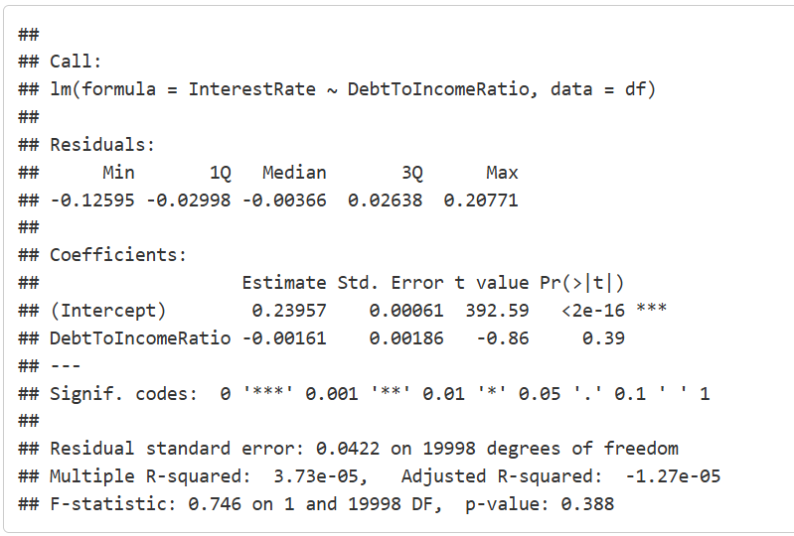
Exploratory Data Analysis (EDA)
2) How does the debt-to-income ratio impact loan approval, interest rates, and risk scores?
Insight:
DebtToIncomeRatio and InterestRate is not statistically significant.

Slide 13
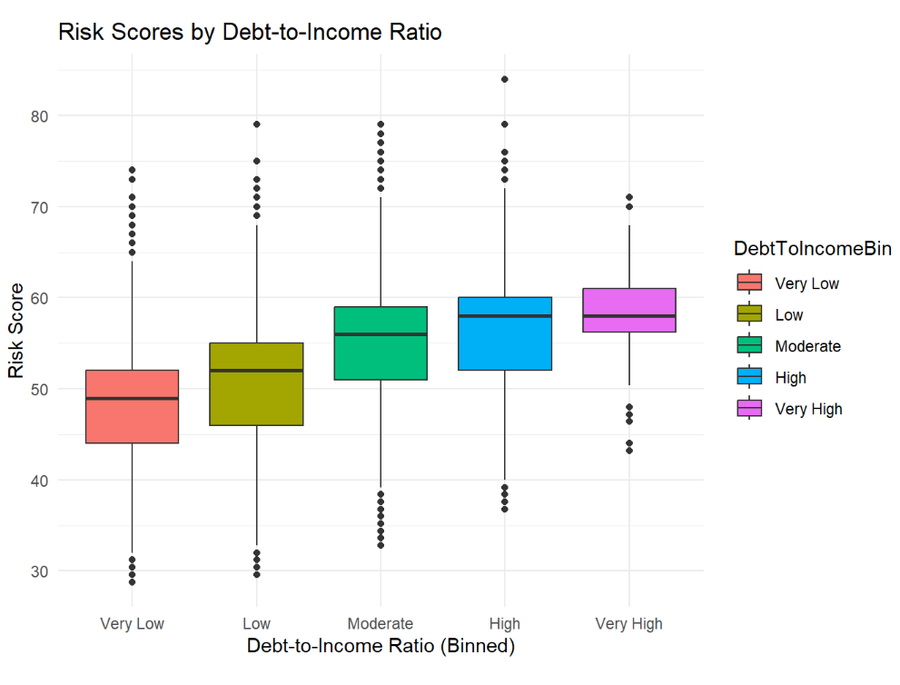
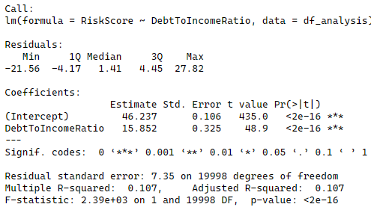
Exploratory Data Analysis (EDA)
2) How does the debt-to-income ratio impact loan approval, interest rates, and risk scores?
Insight:
DebtToIncomeBin has a statistically significant effect on Riskscore.
Higher Debt-to-Income Ratio is associated with higher risk scores

Slide 14
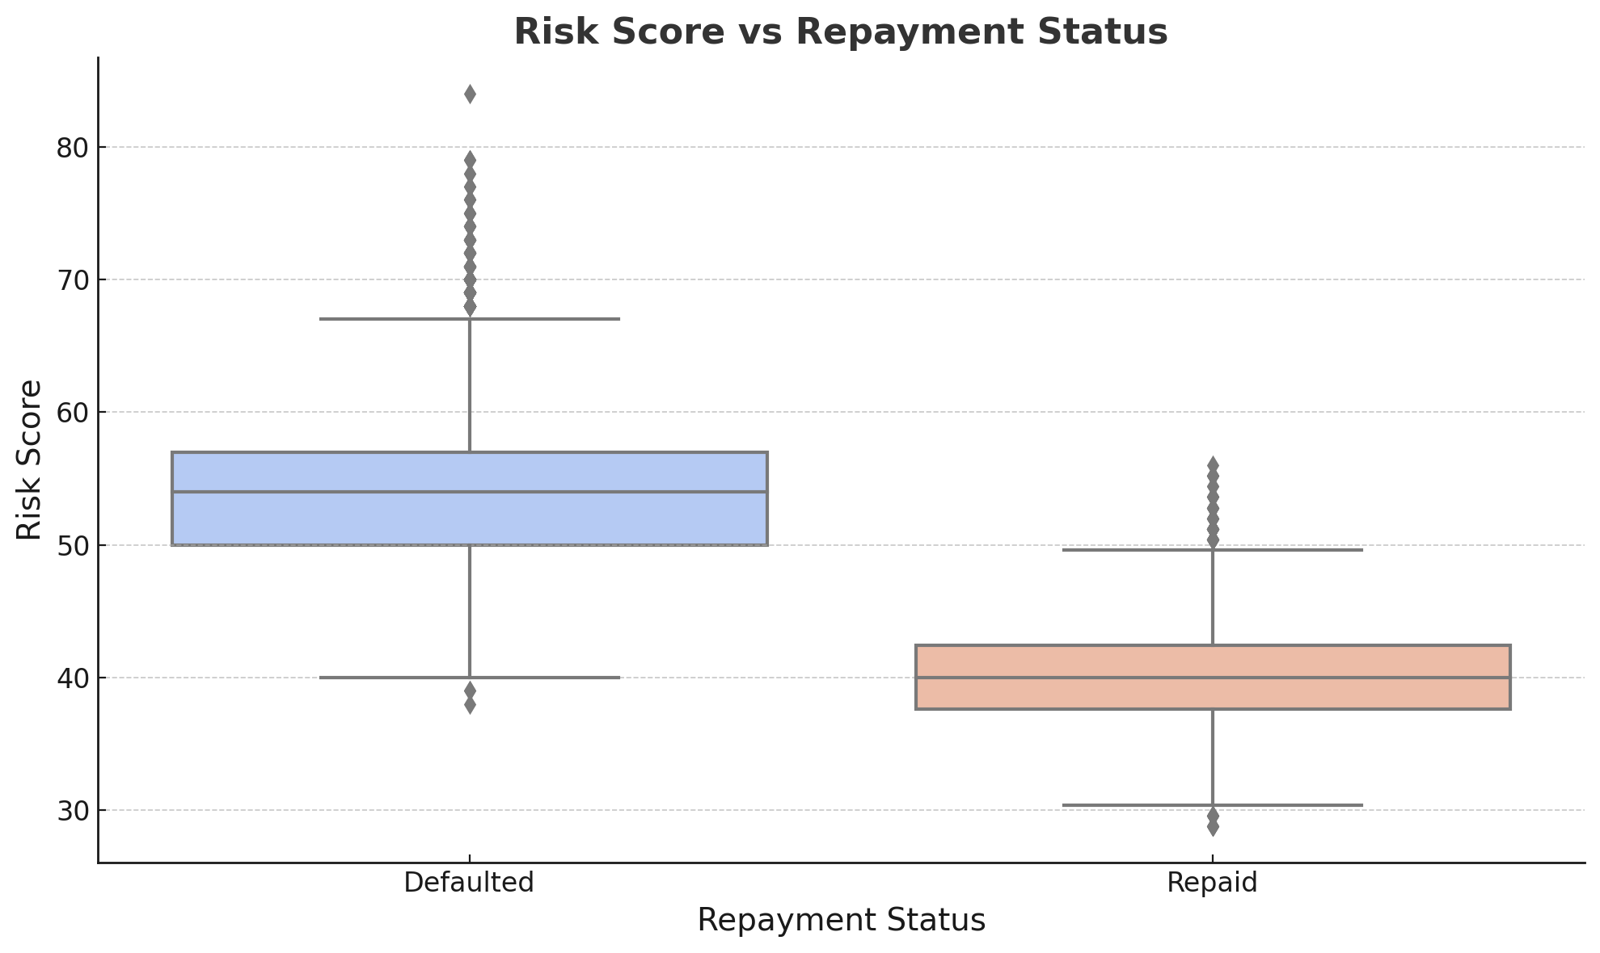
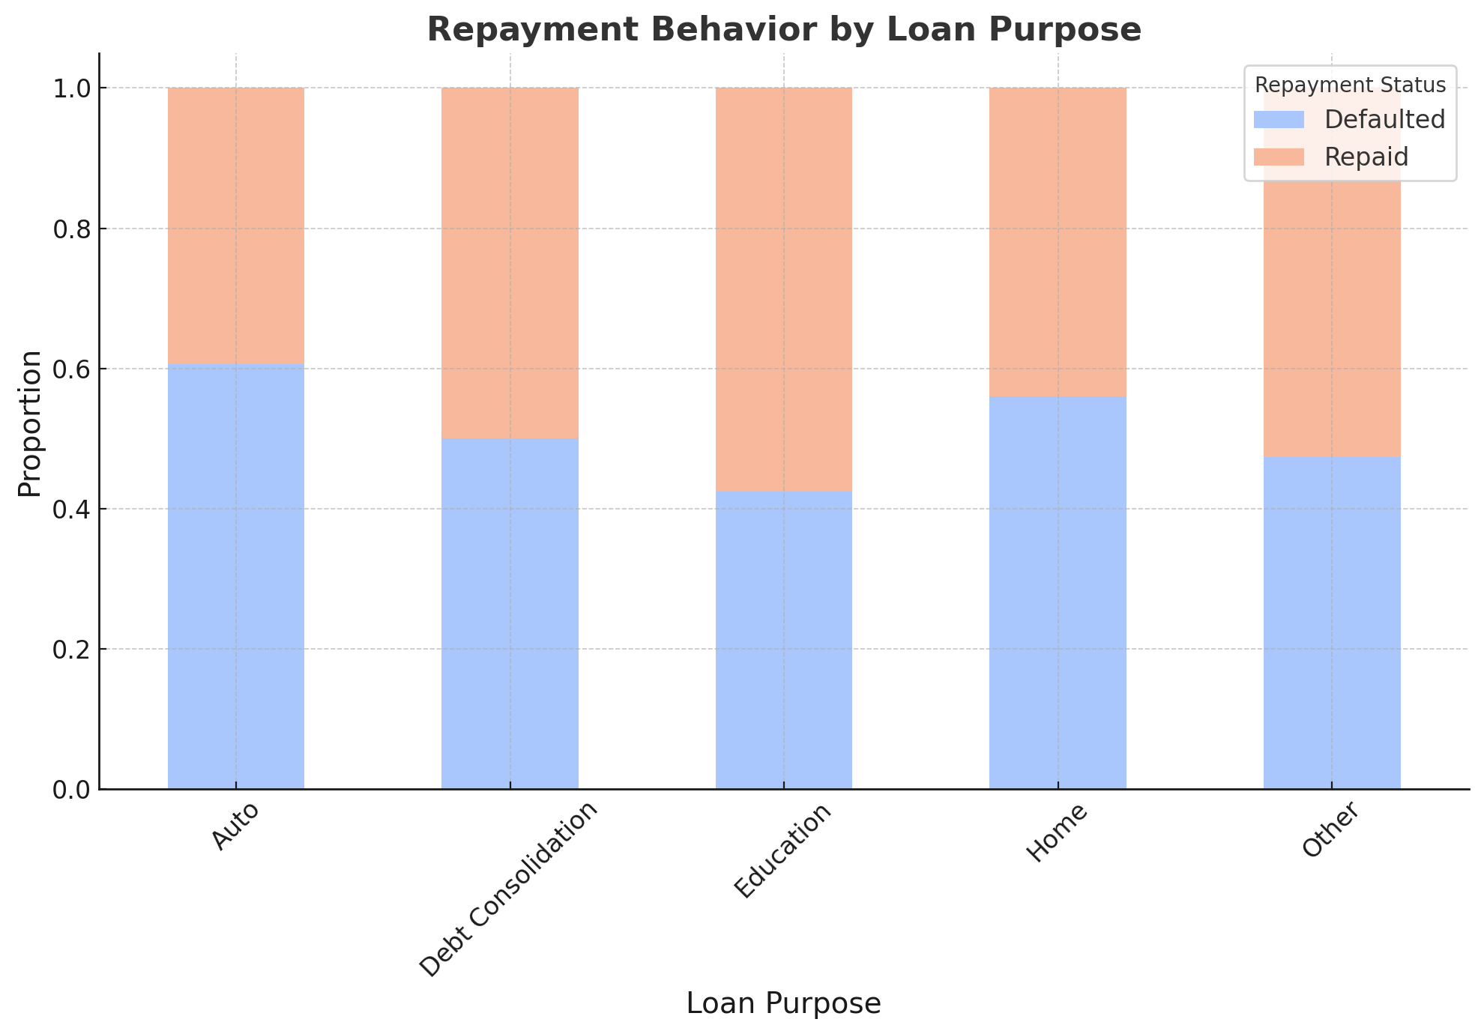
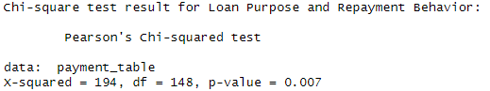
Exploratory Data Analysis (EDA)
3) What is the relationship between loan purpose and repayment behavior, and how does it affect risk?
Chi Square Test : Significant difference between between Loan Purpose and Repayment Behavior (p = 0.007)

Slide 15
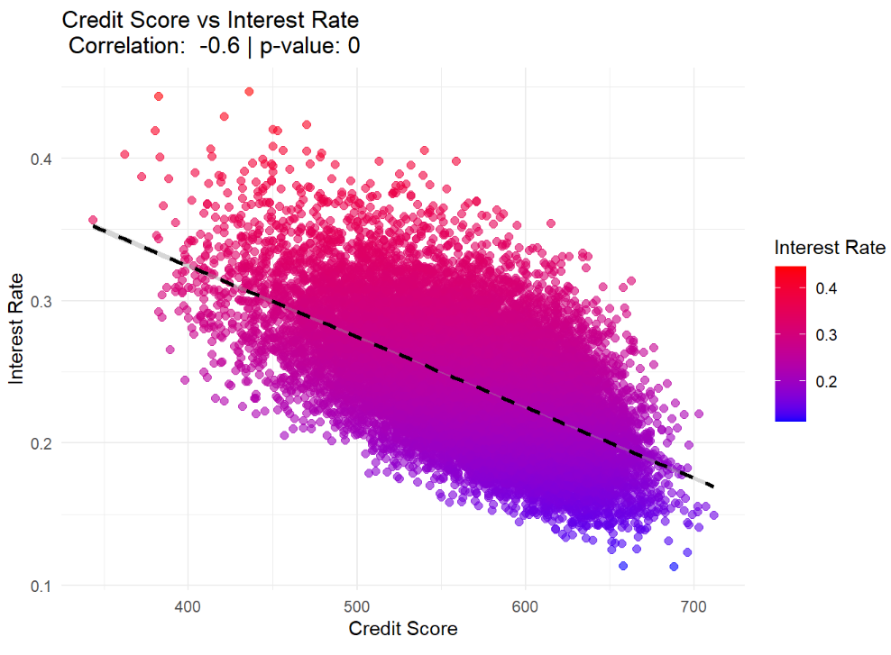
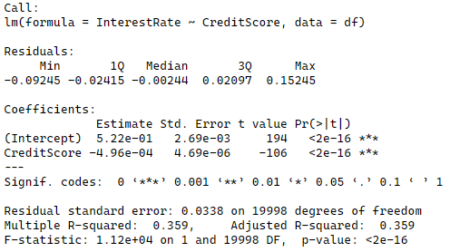
Exploratory Data Analysis (EDA)
4) How does credit score impact interest rates, loan approval, and loan amount?
Insight:
Higher credit scores are associated with lower interest rates

Slide 16
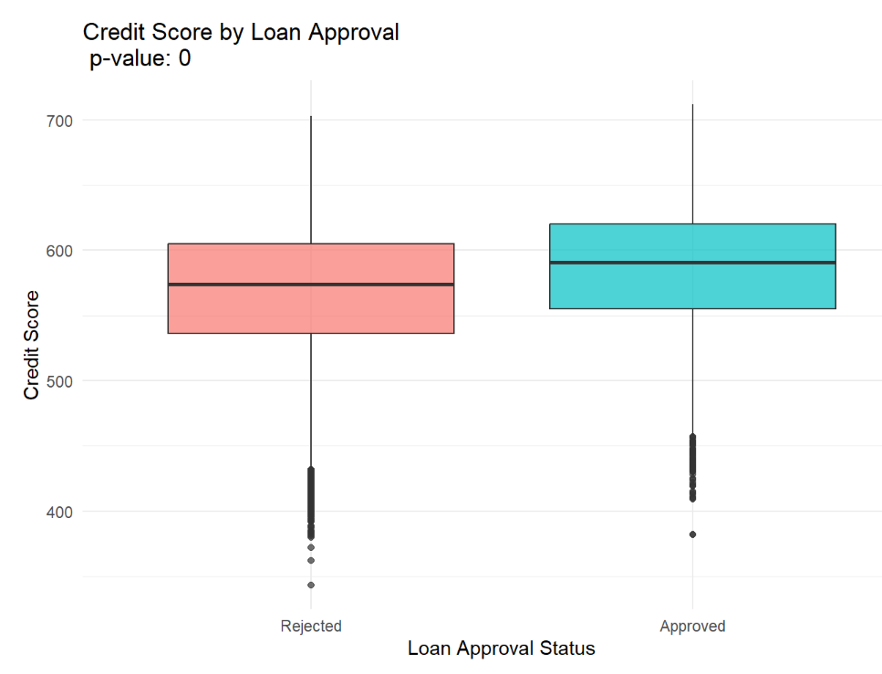
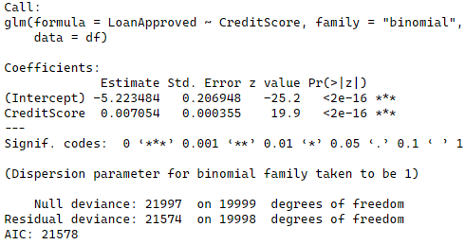
Exploratory Data Analysis (EDA)
4) How does credit score impact interest rates, loan approval, and loan amount?
Insight:
Higher credit scores increase the likelihood of loan approval

Slide 17
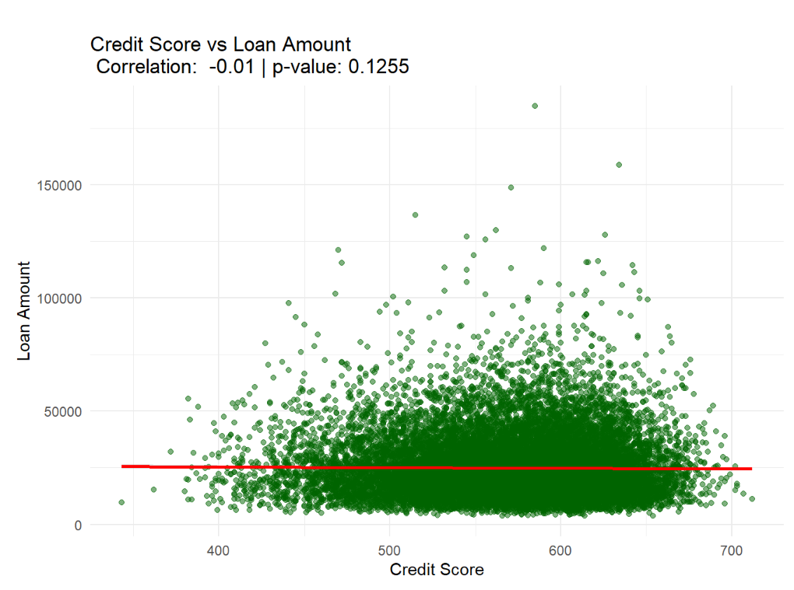
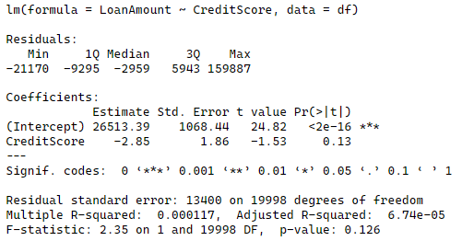
Exploratory Data Analysis (EDA)
4) How does credit score impact interest rates, loan approval, and loan amount?
Insight:
Credit score has no significant impact on loan amounts

Slide 18
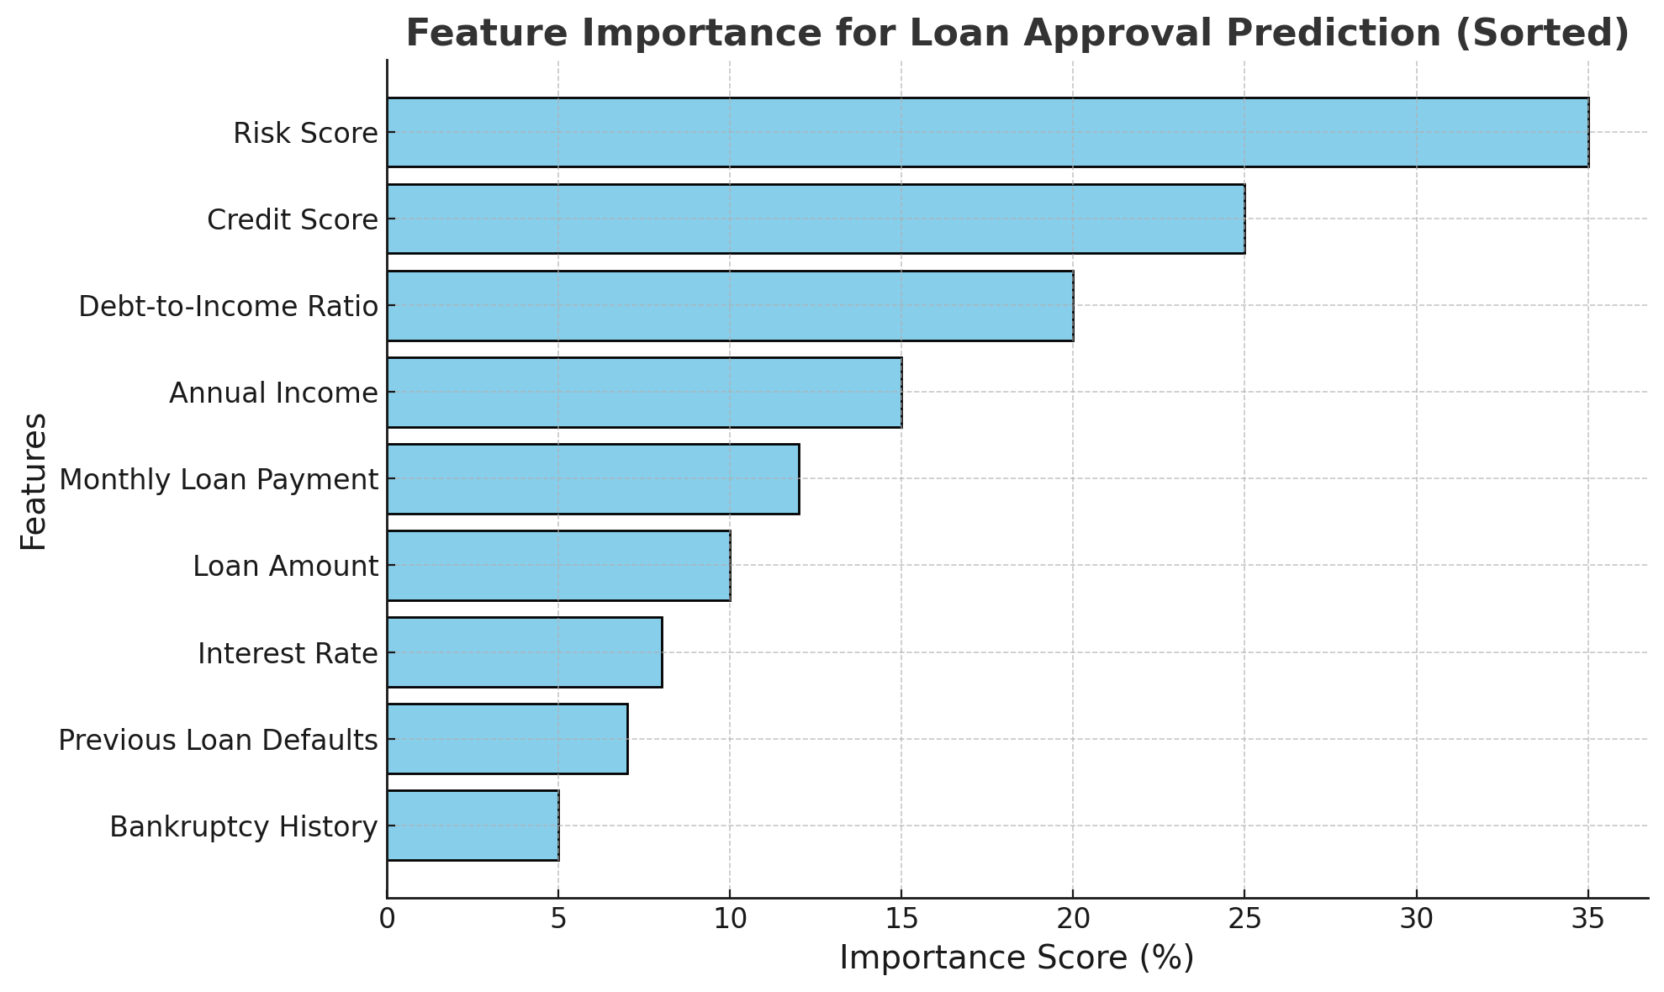
Model Building & Evaluation
5) What are the strongest predictors of loan approval?
Insight:
RFE technique is used to eliminate the least important ones iteratively.
The most important predictors of loan approval are Risk Score, Credit Score, Debt-to-Income Ratio, Annual Income, Monthly Loan Payment, Loan Amount, Interest Rate, Previous Loan Defaults, and Bankruptcy History, with Risk Score being the most significant.

Slide 19
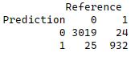
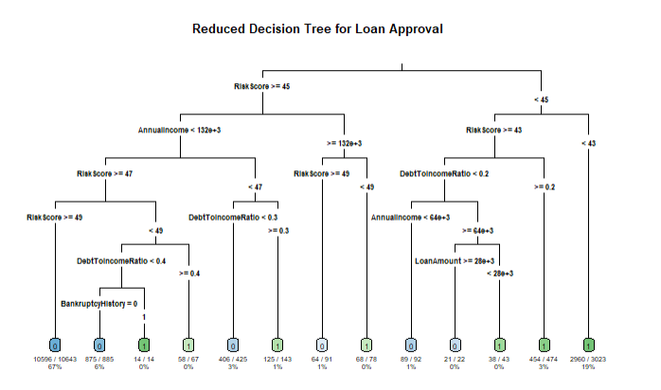
Model Building & Evaluation
Decision Tree Model
Insight:
Training Accuracy – 98.6%
Testing Accuracy – 98.2%
The decision tree model performs exceptionally well in classifying loans based on approval, with high accuracy (98%), balanced sensitivity (97%), and specificity (99%). Key predictors like Risk Score, Debt-to-Income Ratio, and Annual Income drive the model's decisions.

Slide 20
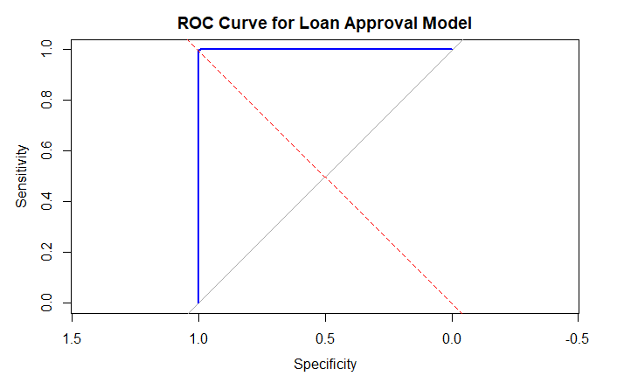
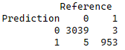
Model Building & Evaluation
Logistic Regression Model
Insight:
Training Accuracy – 99.8%
Testing Accuracy – 99.7%
The logistic regression model performs better that decision tree as it has higher accuracy (99%) and also lower FP and FN rates,

Slide 21
Conclusion
The analysis reveals key insights into loan approval patterns:
Key Predictors: Risk Score, Credit Score, Debt-to-Income Ratio, and Annual Income are the strongest factors influencing loan approval.
Model Performance: The Logistic Regression model outperforms the Decision Tree model with higher accuracy (99.7%) and lower error rates.
Actionable Insights: Higher credit scores and lower risk scores significantly increase approval chances. Low-risk applicants tend to have higher incomes and stable financial profiles.

Slide 22

Any thoughts or questions?

